Slide 1
Lesson 1.3 Introducing Irrational Numbers
Objective
Understand irrational numbers and how they fill the number line.
Use rational numbers to locate irrational numbers approximately on the number line.
Common Core State Standards7.NS.1 & 7.NS.2.d
Mathematical Practices 2. Reason 4. Model mathematics. 5. Use tools strategically. 6. Attend to precision.7. Look for and use structures
Notes:
-Go to learnzillion.com -Enter the code LZ1514 in any search field -Enjoy watching video of exponential expressions/product of powers

Slide 2
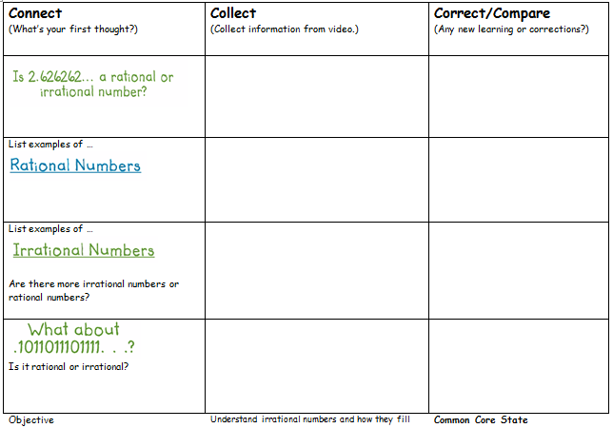
Lesson 1.3 Introducing Irrational Numbers

Slide 3
Lesson 1.3 Introducing Irrational Numbers
Go to Learnzillion
Enter Code LZ2902

Slide 4
Lesson 1.3 Introducing Irrational Numbers
What is the difference between rational and irrational numbers?

Slide 5
Lesson 1.3 Introducing Irrational Numbers
Examples of Irrational Numbers

Slide 6
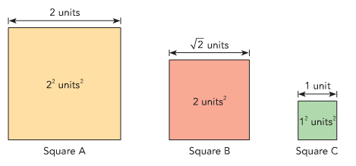
Use Square roots to estimate location or irrational numbers
Notes:
Let’s look at these three squares…Square A has an area of 2^2 (4 square units). So the length is 2 units…show tree diagram underneath. Square C has an area of 1 square unit. Show tree diagram underneath to find square root. Let’s look at Square B…it has an area of 2. Let’s use a tree diagram underneath to help. It is not a perfect square…half of 1 is .5 and half of 2 is 1. so the length is approximately around 1.5

Slide 7
Show approximation on numberline
Notes:
Let’s look at these three squares…Square A has an area of 2^2 (4 square units). So the length is 2 units…show tree diagram underneath. Square C has an area of 1 square unit. Show tree diagram underneath to find square root. Let’s look at Square B…it has an area of 2. Let’s use a tree diagram underneath to help. It is not a perfect square…half of 1 is .5 and half of 2 is 1. so the length is approximately around 1.5

Slide 8
Show approximation on numberline
Notes:
Let’s look at these three squares…Square A has an area of 2^2 (4 square units). So the length is 2 units…show tree diagram underneath. Square C has an area of 1 square unit. Show tree diagram underneath to find square root. Let’s look at Square B…it has an area of 2. Let’s use a tree diagram underneath to help. It is not a perfect square…half of 1 is .5 and half of 2 is 1. so the length is approximately around 1.5

Slide 9
Using your Calculator for square and cube roots
https://www.youtube.com/watch?v=_QavrzE-KXU
Notes:
I see the button for it but everytime I enter √7 (7 just as an example) into the calculator and hit enter, the answer just remains √7. How do you use it so you can get a whole number answer with all the decimals and everything? Thanks! There is a button on the right bottom just above enter labeled with two arrows and two squiggly lines. This converts to decimal.

Slide 10
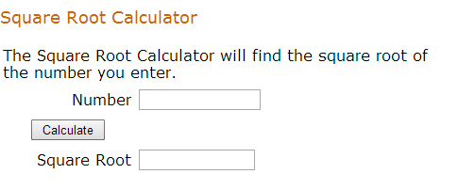
Using your Calculator for square and cube roots
http://www.math.com/students/calculators/source/square-root.htm

Slide 11
Lesson 1.3 Introducing Irrational Numbers
Let’s Try together
What number is 15 in between?

Slide 12
Lesson 1.3 Introducing Irrational Numbers
Let’s Try together
What number is 15 in between? 16 and 14
I know that is 4, so when I graph it will be less than 4

Slide 13
Lesson 1.3 Introducing Irrational Numbers

Slide 14
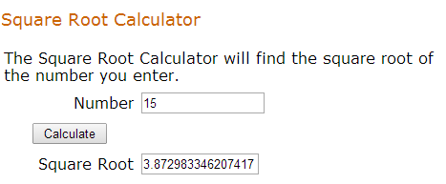
Lesson 1.3 Introducing Irrational Numbers

Slide 15
Lesson 1.3 Introducing Irrational Numbers

Slide 16
Lesson 1.3 Introducing Irrational Numbers

Slide 17
Lesson 1.3 Introducing Irrational Numbers

Slide 18
Lesson 1.3 Introducing Irrational Numbers
Let’s Try together

Slide 19
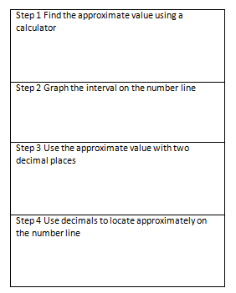
Lesson 1.3 Introducing Irrational Numbers
Let’s Try together

Slide 20
Lesson 1.3 Introducing Irrational Numbers
Independent Practice #1-5
Lesson Check #1/2
(can locate positive irrational numbers on the number line)

Slide 21
Lesson 1.3 Powers of Powers
Understanding of Learning

