Slide 1
Lesson 2.3 Multiplying and Dividing in Scientific Notation (Day 3)
Objective
*multiply and divide numbers in scientific notation by completing 360 degree math
Common Core State Standards 8.EE.4
Mathematical Practices 1.Solve problems/persevere 6. Attend to precision.
Perform operations with numbers expressed in scientific notation, including problems where both decimal and scientific notation are used. Use scientific notation and choose units of appropriate size…Interpret scientific notation that has been generated by technology.
Notes:
-Go to learnzillion.com -Enter the code LZ1514 in any search field -Enjoy watching video of exponential expressions/product of powers

Slide 2
Lesson 2.3 Multiplying and Dividing in Scientific Notation (Day 3)
Notes:
-Go to learnzillion.com -Enter the code LZ1514 in any search field -Enjoy watching video of exponential expressions/product of powers

Slide 3
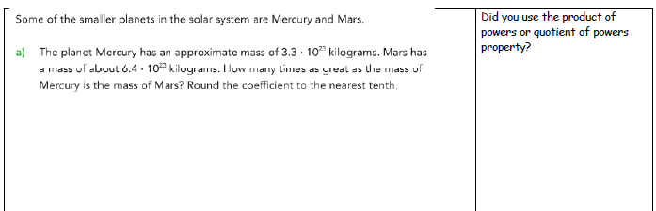
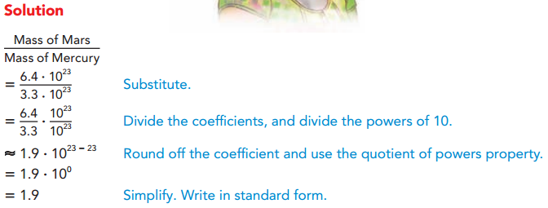
Lesson 2.3 Multiplying and Dividing in Scientific Notation (Day 3)
Guided Practice

Slide 4
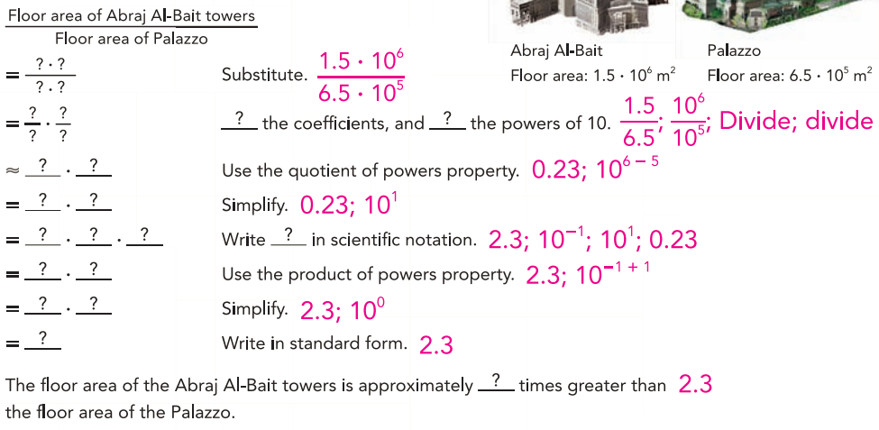
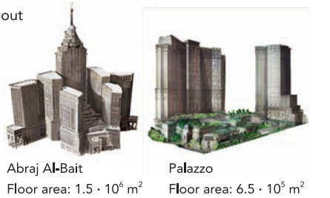
Lesson 2.3 Multiplying and Dividing in Scientific Notation (Day 3)
Your Turn- Look inside purple math book

Slide 5
Lesson 2.3 Multiplying and Dividing in Scientific Notation (Day 3)
Your Turn- Look inside purple math book

Slide 6
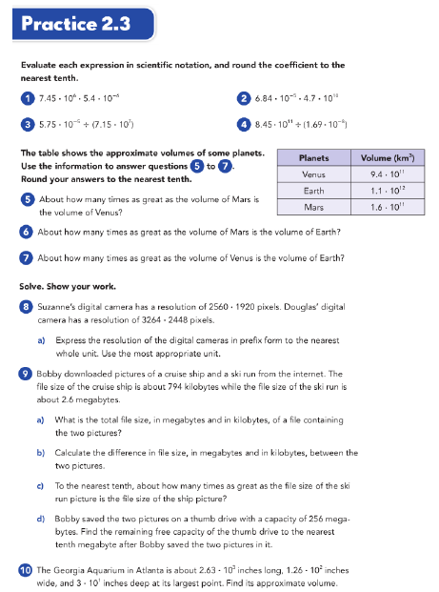
Lesson 2.3 Multiplying and Dividing in Scientific Notation (Day 3)
Guided Practice #1-7 & #8-14 Challenge

Slide 7
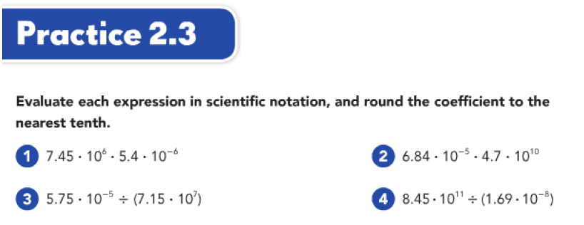
Lesson 2.3 Multiplying and Dividing in Scientific Notation (Day 3)
Guided Practice

Slide 8
Lesson 2.3 Multiplying and Dividing in Scientific Notation (Day 3)
Guided Practice

Slide 9
Lesson 2.3 Multiplying and Dividing in Scientific Notation (Day 3)
Guided Practice

Slide 10
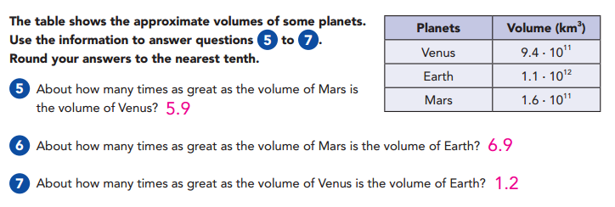
Lesson 2.3 Multiplying and Dividing in Scientific Notation (Day 3)
Guided Practice

Slide 11
Lesson 2.3 Multiplying and Dividing in Scientific Notation (Day 3)
Notes:
-Go to learnzillion.com -Enter the code LZ1514 in any search field -Enjoy watching video of exponential expressions/product of powers

Slide 12
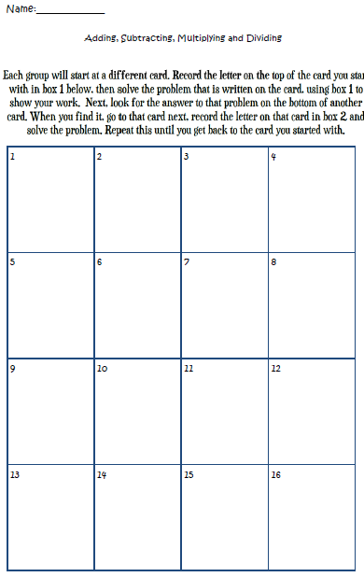
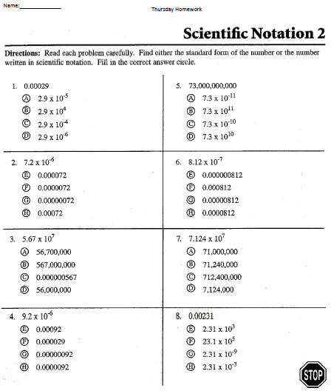
Lesson 2.3 Multiplying and Dividing in Scientific Notation (Day 3)
Independent Practice- 360 Math Homework
Lesson Check #Add, subtract, multiply and divide in scientific notation

