Slide 1
All about Azmerit

Slide 2
Ticket In
Please make sure all of your students have a testing ticket for AIMS Science
SPED teachers-please highlight your students from grade-level and collect tickets from homeroom teacher

Slide 3
Overview
*verify all of your homeroom students are ready for testing (test ticket)
*review responsibilities of Test Administrator including training and test security
*discuss ways to support before, during, and after testing

Slide 4
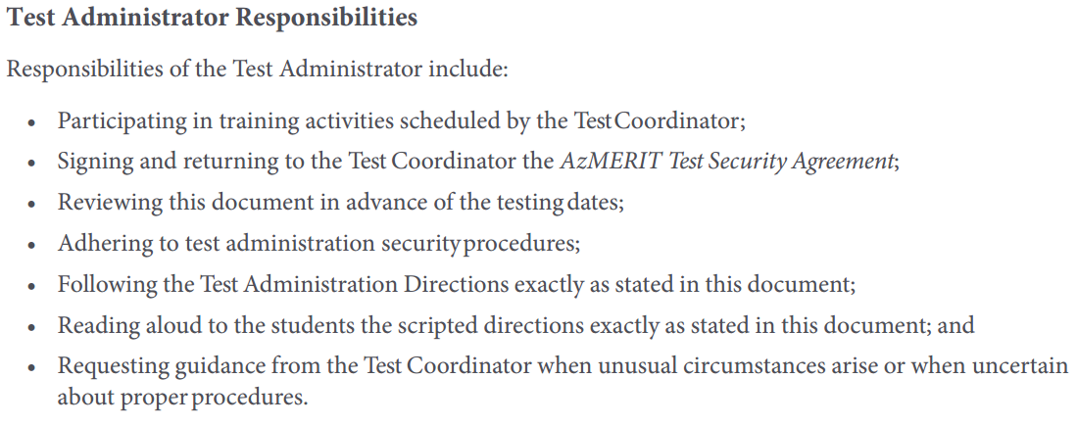
Responsibilities
Notes:
pg 1 of 2017 manual

Slide 5
Testing Schedule
*Test in your subject areas ☺
Notes:
page 3 of manual- testing days can be administered in ANY ORDER…significant change for 5th grade…can test in your homeroom

Slide 6
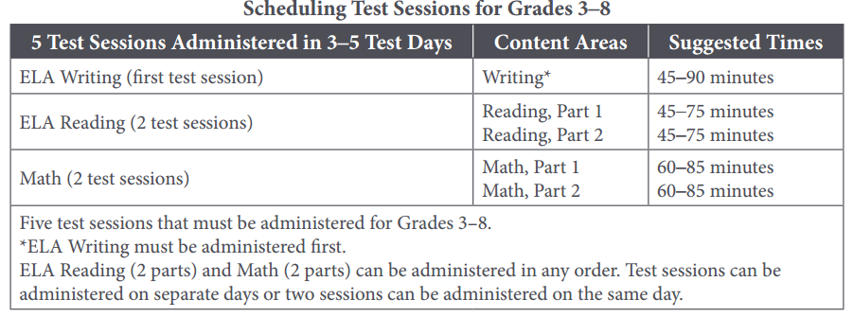
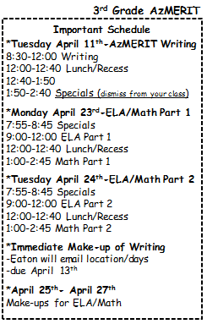
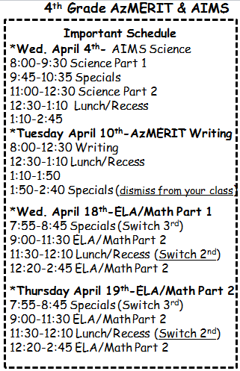
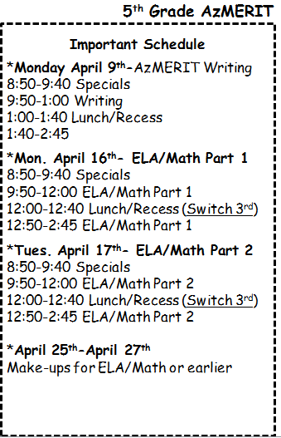
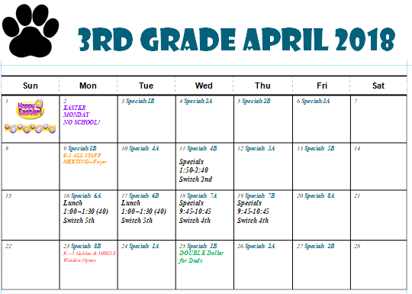
Testing Schedule
Notes:
Page 3 Change- 3rd grade was due earlier for testing…this year is not the case. HOWEVER, testing window closes earlier than last year. ONLY 2 days for 3rd grade make-ups

Slide 7
Help with Make-ups
Please fill out Google Doc for EACH Session and Teacher Name (look at bottom TAB for grade level)
Notes:
Window closes earlier this year. Please be diligent to help support make-ups. The manual states that students can complete missed test in any order. However, the deadlines will be adhered first

Slide 8
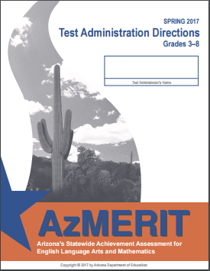
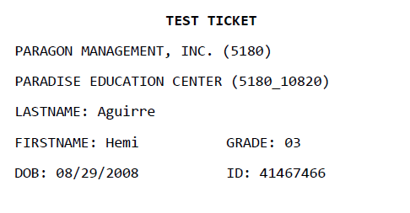
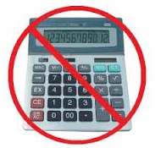
Test Materials
TA’s must have copy of manual
Please POST “Testing- Do Not Disturb Sign” on door
Scratch Paper is allowed for all sections of AzMERIT (plain, lined, or graph)
Notes:
page 4 of Testing Manual- states all TA’s must have electronic copy (online or my website). New this year- scratch paper is allowed for all sections of AzMERIT. If you need Pencils or scratch paper then please let me know prior to testing. Calculators are prohibited. Under Universal Accommodations- students of CBT may opt to use a paper dictionary or thesaurus during testing rather than online tool in WRITING section of AzMERIT

Slide 9
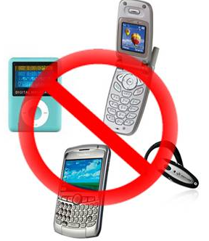
Use of Unacceptable Resources
Notes:
page 6 of Testing Manual- remove violation and allow student to continue testing. Contact testing coordinator about unacceptable resources

Slide 10
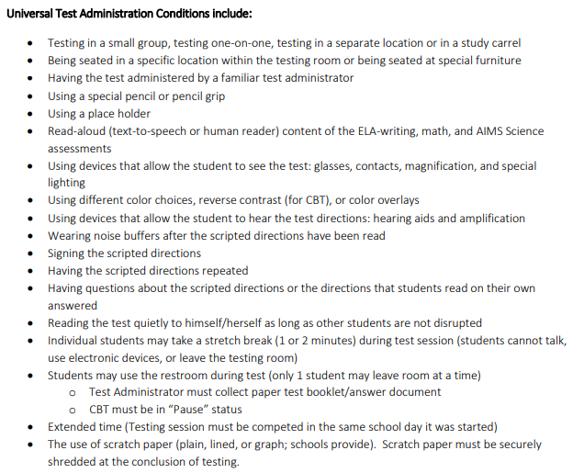
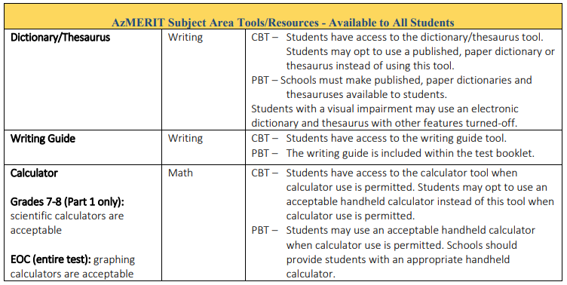
Testing Accommodations
Universal Accommodations
Notes:
Universal Accommodations- guide found on AzMERITportal under resources. page 17 & 22 print

Slide 11
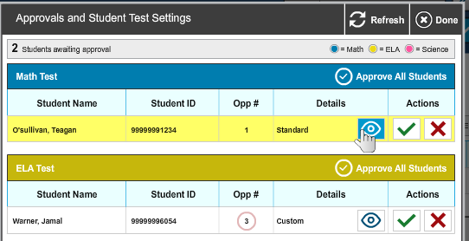
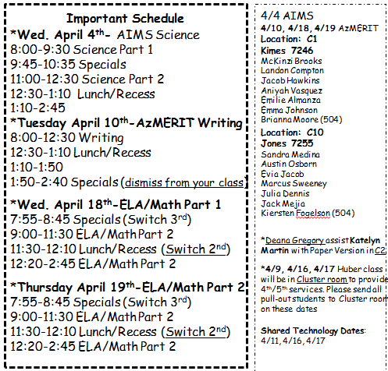
Testing Accommodations
Accommodations for Students with Disabilities
*Hearing-Closed Captioning
*Visual- contrast, special large paper version
*Small Group provided outside classroom
Notes:
NEED PRINT OUT-Small GROUP Google Doc
page 6 of Testing Manual – Students with accommodations have already been added to TIDE. There are two accommodations that will be used 1) hearing and vision needs 2) Small Group The testing Administrator must know which students are eligible for accommodations AND must provide accommodations. First way to check for custom accommodations is on the approval screen. Look on Approvals screen for CUSTOM setting.

Slide 12
Before AzMERIT Administration

Slide 13
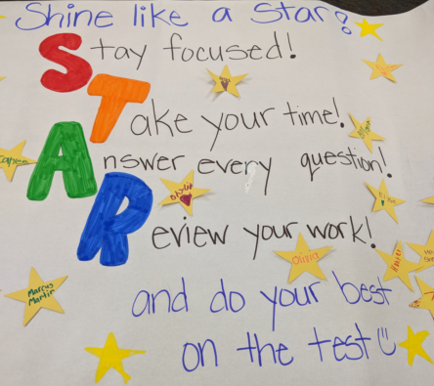
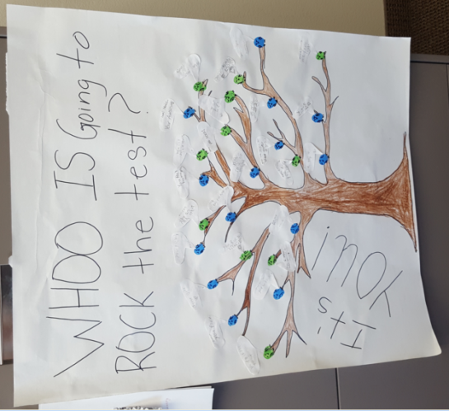
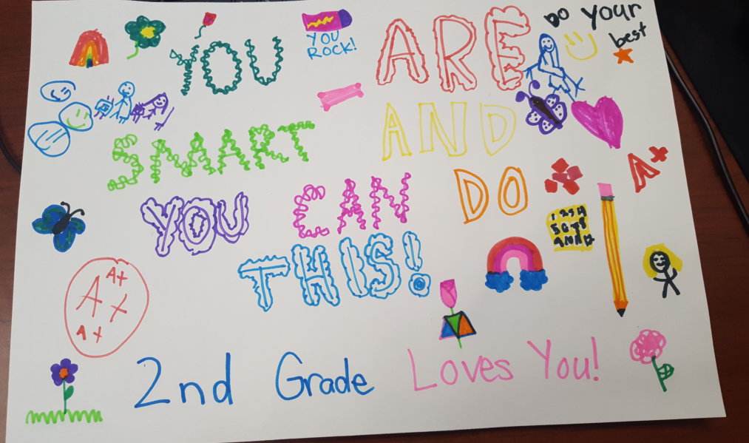
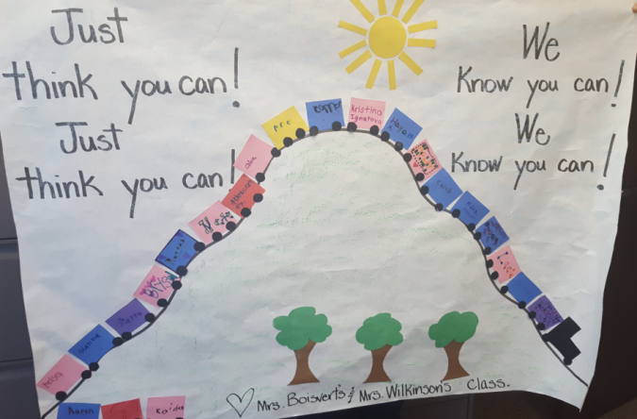
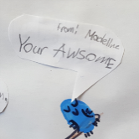
Prepare the Room
Students’ desks and tables should be cleared of backpacks and unnecessary materials prior to the beginning of the test session
Notes:
page 6 of Testing Manual- K-2 students have created posters for your students to ENCOURAGE your students SEE Google Doc for K-2 Classroom that has adopted you

Slide 14
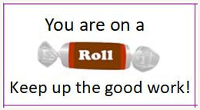
Other Ways to be Encourages
*Morning Announcements (song from Mrs Payne’s class
*Merit Man delivering treats (assembled by Student Council)
*Testing t-Shirts
Notes:
page 6 of Testing Manual- K-2 students have created posters for your students to ENCOURAGE your students SEE Google Doc for K-2 Classroom that has adopted you

Slide 15
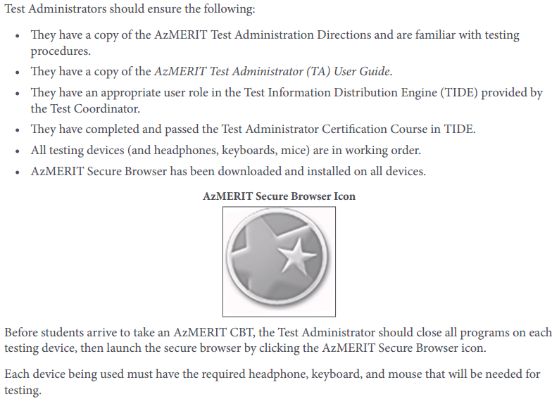
Preparing the Room (Cont)
T﻿he student sign-in screen should be showing when students enter the room to take the test. In the event of technical difficulties with the secure browser, contact your Test Coordinator.
Notes:
page 7 of Testing Manual- Be aware that the student sign-in screen should be showing when students enter room to take the test

Slide 16
During AzMERIT Administration

Slide 17
Preparing for Computer-Based Testing
*Please review the directions in advance to become familiar with the scripted text and testing procedures.
.
*Read aloud to students only what is marked with a “SAY” and printed in the boxes
Pgs 16-19 Writing
Pgs 20-23 ELA Part 1 or 2
Pgs 24-27 Math Part 1 or 2
Notes:
page 16 of Testing Manual- Be sure to TAB these pages for CBT only

Slide 18
Monitoring Student Testing
*continuously move about the room
Notes:
page 11 of Testing Manual-continuously move around room to ensure using appropriate testing materials and resources

Slide 19
Breaks DURING Testing
The student must pause his or her test before leaving the room. The student will be required to sign in to his or her test when he or she returns to the room, and the Test Administrator will need to approve the student again
20 minute MAX time to have test paused
Notes:
page 9 of Testing Manual- Individual students may use restroom…must pause test and then log back in. Once leave the testing room, then the session will be over. Page 12- tells 20 minute MAX time

Slide 20
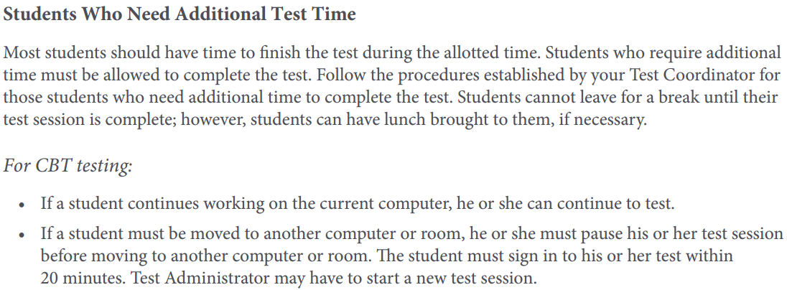
Students Who need Additional Time
3:00 pm
Lunch Overflow Room
Which classroom would like to be designated as the Lunch Overflow room?
-Text Angela to bring lunches to students OR ask team mate to help
-Continue testing/must log in BEFORE 20 minutes have passed
-Remaining Students from Lunch Overflow room farmed out (email list Synthia please)
Notes:
page 12 of Testing Manual- Must be allowed to finish test—can go up to 3:00 pm

Slide 21
Students Who Leave DURING testing
The Test Administrator should inform the student that he or she will not be permitted to finish that session when the student returns to school.
Notes:
page 11 of Testing Manual- Must be allowed to finish test—can go up to 3:00 pm

Slide 22
Field Test Items
*Do Best
*Not used for student scores or measure student growth
Notes:
page 9 of Testing Manual-

Slide 23
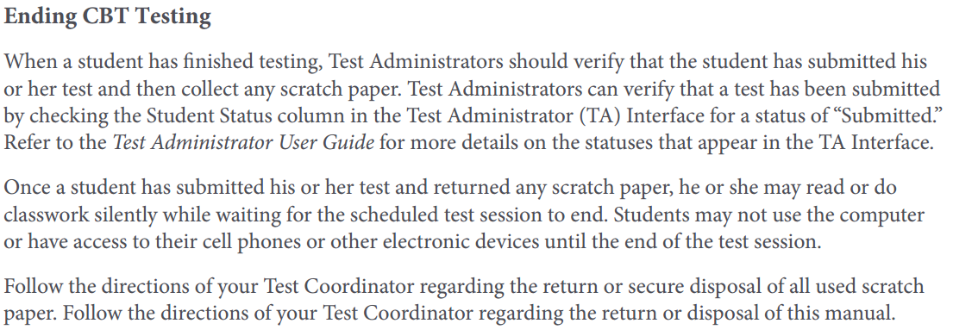
End of AzMERIT Testing
*verify that the student has submitted his or her test (Interface)
*collect any scratch paper
*once finished then students will read or do classwork silently
MAY NOT USE THE COMPUTER until the end of testing
Notes:
Page 11 of Testing Manual-

Slide 24
Practicing for Azmerit

Slide 25
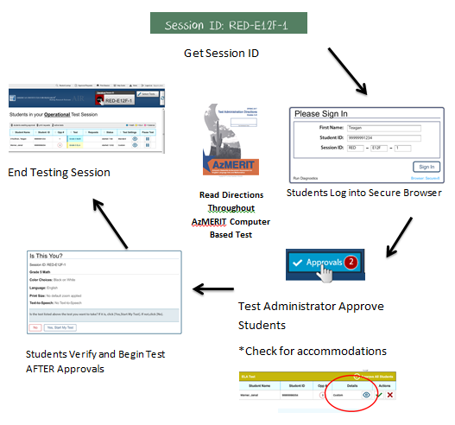
Friday April 6th 3:00-3:30 Cluster Room
*Launch the AzMERIT Secure Browser on each student Chromebook *Write the Session ID clearly on the board *Post “Testing Do Not Disturb Sign” *Distribute testing tickets *Distribute Scratch Paper
Notes:
Slide 28 of Course Administration has a practice interface you may use to practice starting a session

