Slide 1
All about Azmerit

Slide 2
Ticket In
Please make sure all of your students have a testing ticket for AzMERIT
SPED teachers-please highlight your students from grade-level and collect tickets from homeroom teacher

Slide 3
Overview
*verify all of your homeroom students are ready for testing (test ticket)
*review responsibilities of Test Administrator including test security and accommodations
*discuss ways to support before, during, and after testing

Slide 4
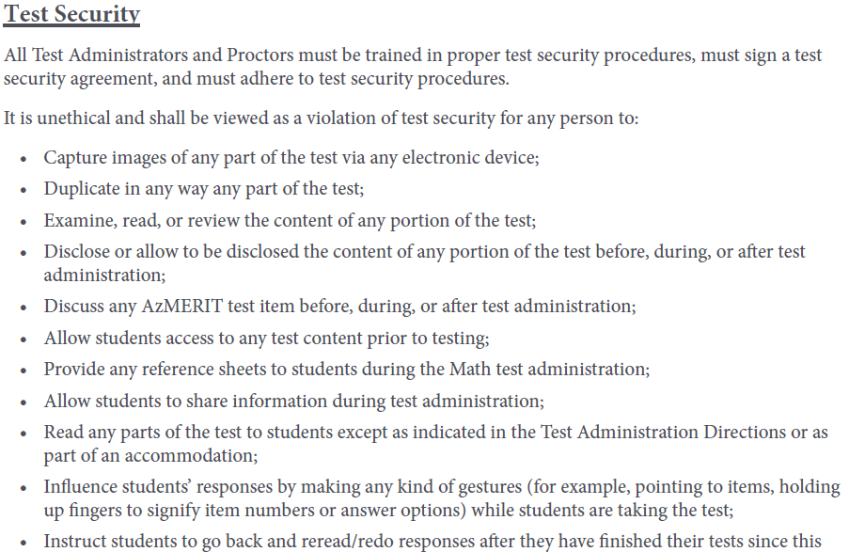
Test Security
*Page 1
*Page 5
Test Security
Notes:
pg 1 (focus on training activities) and page 5 (sign Test Security Agreement– see page 5 for specifics)
Test Security for Teachers

Slide 5
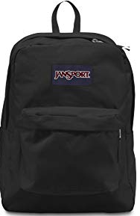
Largest Source of Test Security Violation
Notes:
page 6 of Testing Manual- remove violation and allow student to continue testing. Contact testing coordinator about unacceptable resources
Test Security for Students

Slide 6
Responsibilities
Notes:
pg 1 and page 2

Slide 7
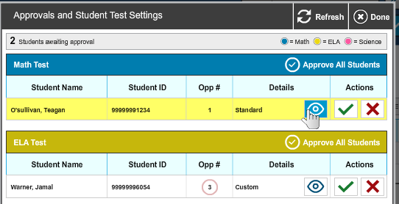
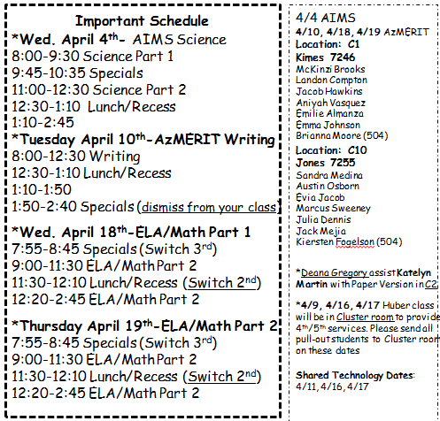
Responsibility Accomodations
Accommodations for Students with Disabilities
*Hearing-Closed Captioning
*Visual- contrast, special large paper version
*Small Group provided outside classroom
Notes:
NEED PRINT OUT-Small GROUP Google Doc
page 6 of Testing Manual – Students with accommodations have already been added to TIDE. There are two accommodations that will be used 1) hearing and vision needs 2) Small Group The testing Administrator must know which students are eligible for accommodations AND must provide accommodations. First way to check for custom accommodations is on the approval screen. Look on Approvals screen for CUSTOM setting.

Slide 8
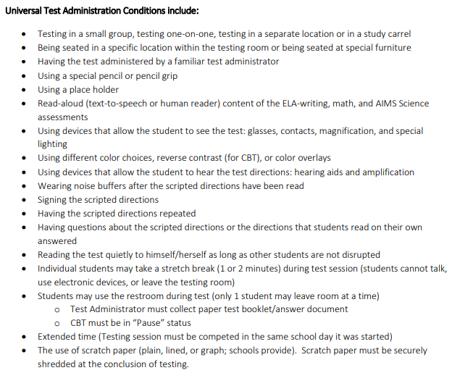
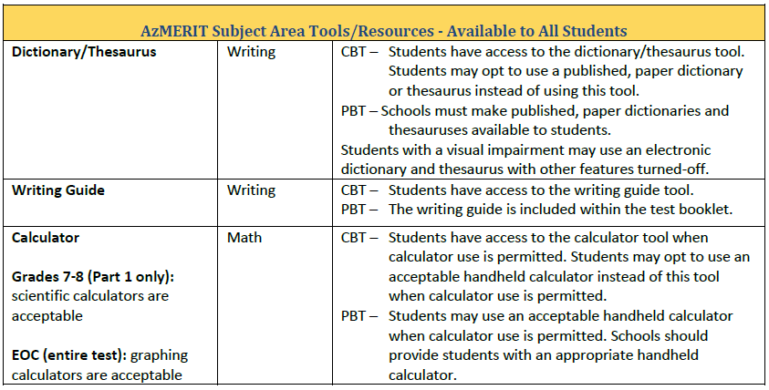
Testing Accommodations
Universal Accommodations
Notes:
Universal Accommodations- guide found on AzMERITportal under resources. page 17 & 22 print

Slide 9
Logistics

Slide 10
Testing Schedule
*Page 3
*Test in your subject areas ☺
Notes:
page 3 of manual- testing days can be administered in ANY ORDER…significant change for 5th grade…can test in your homeroom

Slide 11
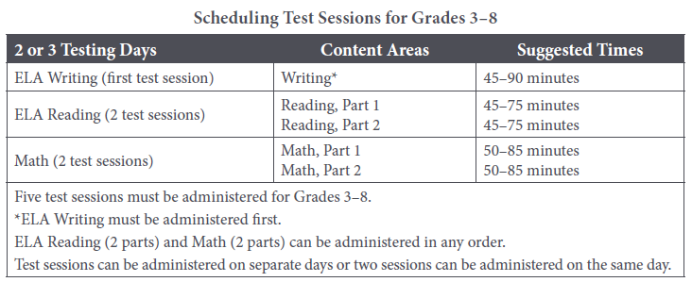
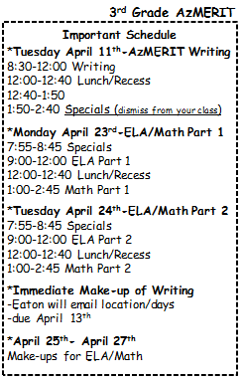
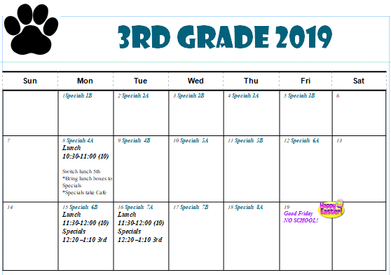
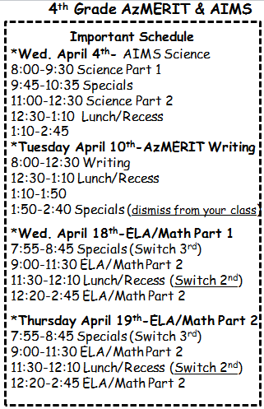
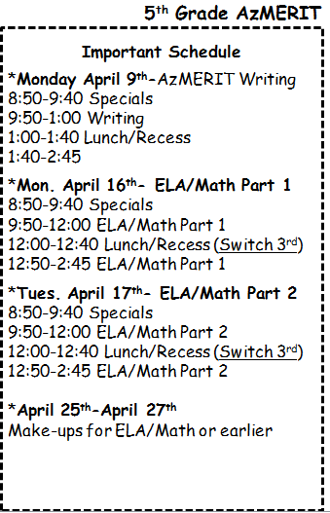
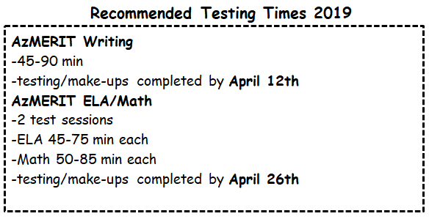
Testing Schedule
Notes:
Page 3 look at back of Important Schedule for dates that end

Slide 12
Help with Make-ups
Please fill out Google Doc for EACH Session and Teacher Name (look at bottom TAB for grade level)
Notes:
Window closes earlier this year. Please be diligent to help support make-ups. The manual states that students can complete missed test in any order. However, the deadlines will be adhered first

Slide 13
Before AzMERIT Administration

Slide 14
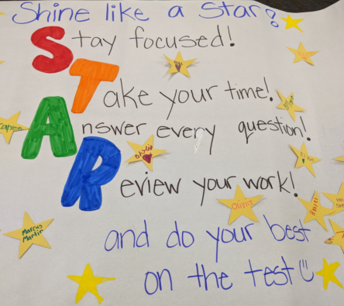
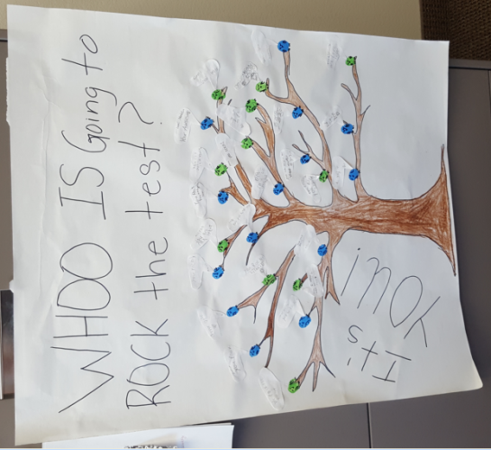
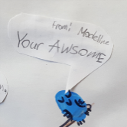
Prepare the Room
Students’ desks and tables should be cleared of backpacks and unnecessary materials prior to the beginning of the test session
Notes:
page 6 of Testing Manual- K-2 students have created posters for your students to ENCOURAGE your students SEE Google Doc for K-2 Classroom that has adopted you

Slide 15
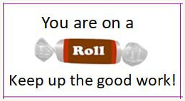
Other Ways to be Encouraged
*Merit Man delivering treats (assembled by Student Council)
*Testing t-Shirts
*Do Your Best Banners
Notes:
page 6 of Testing Manual- K-2 students have created posters for your students to ENCOURAGE your students SEE Google Doc for K-2 Classroom that has adopted you

Slide 16
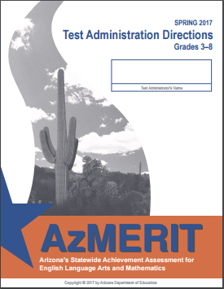
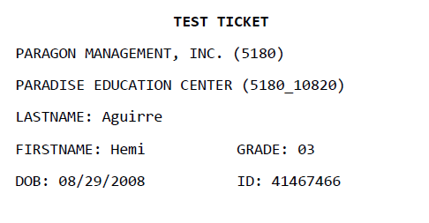
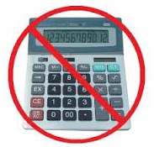
Test Materials
TA’s must have copy of manual
Please POST “Testing- Do Not Disturb Sign” on door
Scratch Paper is allowed for all sections of AzMERIT (plain, lined, or graph)
Notes:
page 4 of Testing Manual- states all TA’s must have electronic copy (online or my website). New this year- scratch paper is allowed for all sections of AzMERIT. If you need Pencils or scratch paper then please let me know prior to testing. Calculators are prohibited. Under Universal Accommodations- students of CBT may opt to use a paper dictionary or thesaurus during testing rather than online tool in WRITING section of AzMERIT

Slide 17
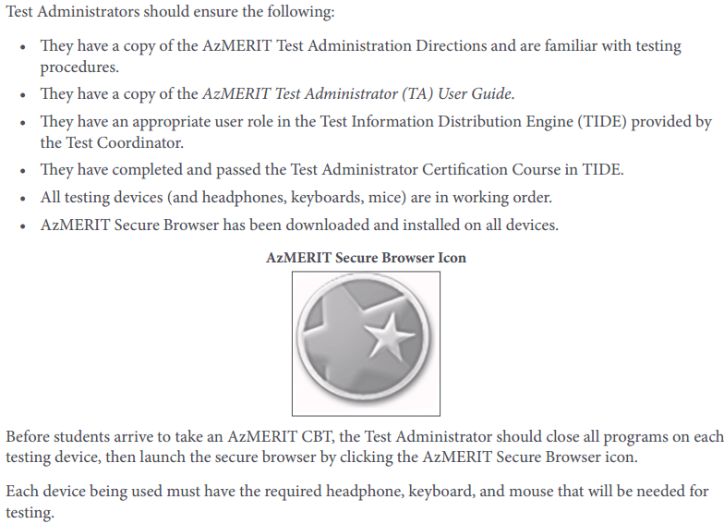
Preparing the Room (Cont)
T﻿he student sign-in screen should be showing when students enter the room to take the test. In the event of technical difficulties with the secure browser, contact your Test Coordinator.
Notes:
page 7 of Testing Manual- Be aware that the student sign-in screen should be showing when students enter room to take the test

Slide 18
During AzMERIT Administration

Slide 19
Preparing for Computer-Based Testing
*Please review the directions in advance to become familiar with the scripted text and testing procedures.
.
*Read aloud to students only what is marked with a “SAY” and printed in the boxes
Pgs 16-19 Writing
Pgs 20-23 ELA Part 1 or 2
Pgs 24-27 Math Part 1 or 2
Notes:
page 16 of Testing Manual- Be sure to TAB these pages for CBT only

Slide 20
Monitoring Student Testing
*continuously move about the room
Notes:
page 11 of Testing Manual-continuously move around room to ensure using appropriate testing materials and resources

Slide 21
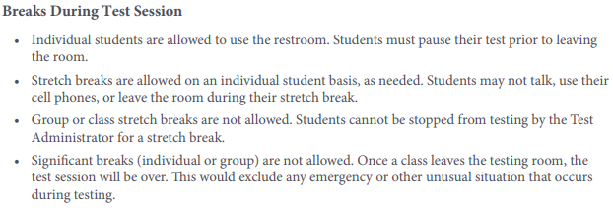
Breaks DURING Testing
The student must pause his or her test before leaving the room. The student will be required to sign in to his or her test when he or she returns to the room, and the Test Administrator will need to approve the student again
Estimate Time of Pause
*10-15 min (Restroom)
*Hour or so (Nurse)
Notes:
page 9 of Testing Manual- Individual students may use restroom…must pause test and then log back in.
In years prior, the MAX pause time was 20 minutes. Asked test coordinator for clarification this year of max time of pause since it is not listed in Testing Coordinator manual or TA manual.
1/8/2018There should not be a significant pause for students. Typically a student will pause the test to use the restroom or move to another room to continue testing. This shouldn’t take more than 10-15 minutes. If a student needs to go to the nurse, he or she can pause the test for up to an hour or so if needed. The test administrator will need to keep the session open until the student submits the test.
Margaret Bowerman

Slide 22
Students Who need Additional Time
2:30 pm
Lunch Overflow Room
Which classroom would like to be designated as the Lunch Overflow room?
-Text Angela to bring lunches to students OR ask team mate to help
-Continue testing/must log in (NEW THIS YEAR- no 20 min timeframe)
-Remaining Students from Lunch Overflow room farmed out (email list Synthia please)
Notes:
page 12 of Testing Manual- Must be allowed to finish test—can go up to 2:30 pm (3:00pm with parent permission)
New this year- the 20 minute timeframe of movement has been removed

Slide 23
Students Who Leave DURING testing
The Test Administrator should inform the student that he or she will not be permitted to finish that session when the student returns to school.
Notes:
page 11 of Testing Manual- Must be allowed to finish test—can go up to 2:30 pm (3:00 with parent permission)

Slide 24
Field Test Items
*Do Best
*Not used for student scores or measure student growth
Notes:
page 9 of Testing Manual-

Slide 25
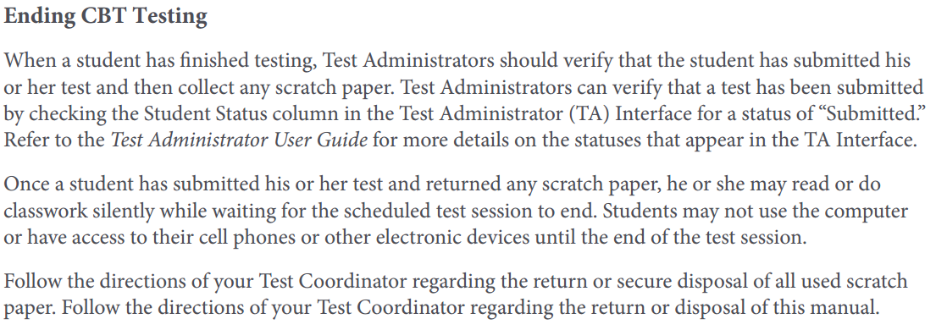
End of AzMERIT Testing
*verify that the student has submitted his or her test (Interface)
*collect any scratch paper
*once finished then students will read or do classwork silently
MAY NOT USE THE COMPUTER until the end of testing
Notes:
Page 12 of Testing Manual-

Slide 26
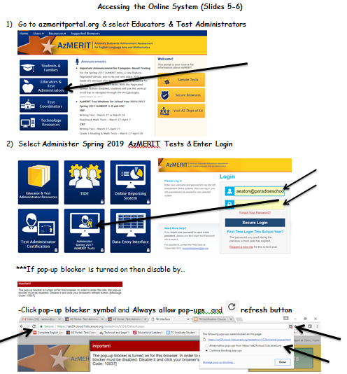
Practicing for Azmerit

Slide 27
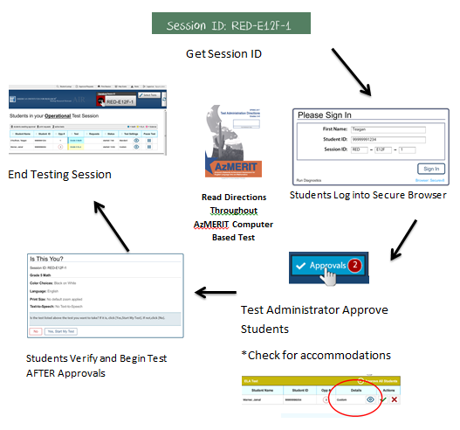
Wednesday April 3rd 3:00-3:30 Friday April 5th 2:30-3:30 Cluster Room
*Launch the AzMERIT Secure Browser on each student Chromebook *Write the Session ID clearly on the board *Post “Testing Do Not Disturb Sign” *Distribute testing tickets *Distribute Scratch Paper
Notes:
Slide 28 of Course Administration has a practice interface you may use to practice starting a session

