Slide 1
All about Azmerit

Slide 2
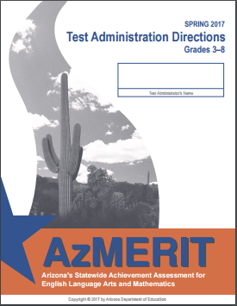
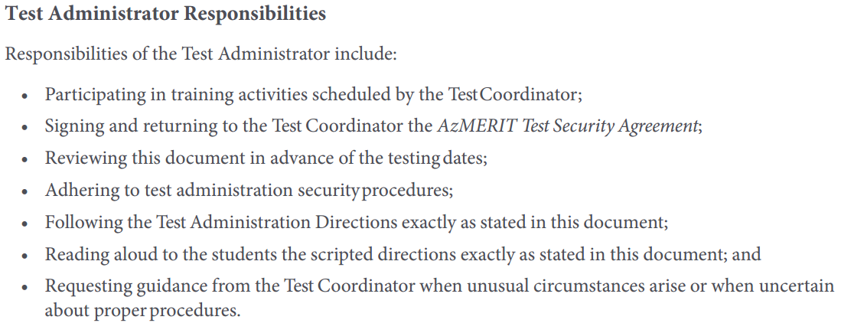
Responsibilities
Notes:
pg 1 of 2017 manual

Slide 3
Testing Schedule
Notes:
page 2 of manual- testing days can be administered in ANY ORDER…significant change for 5th grade…can test in your homeroom

Slide 4
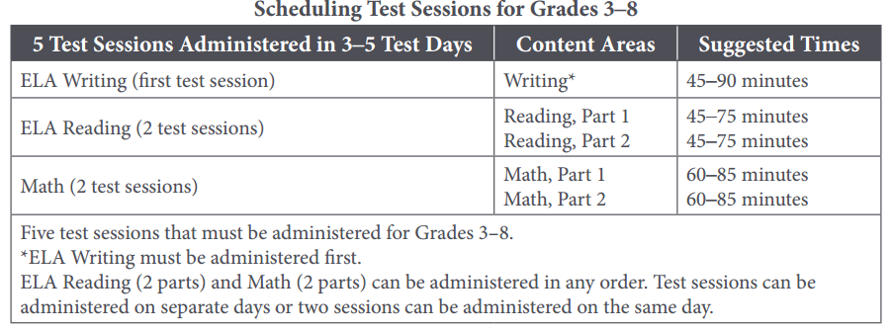
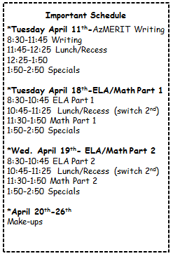
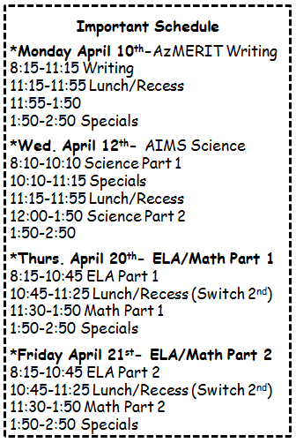
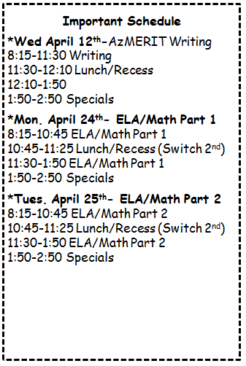
Testing Schedule
Notes:
Page 3 IMPORTANT TO NOTE That make-ups are due earlier for 3rd grade

Slide 5
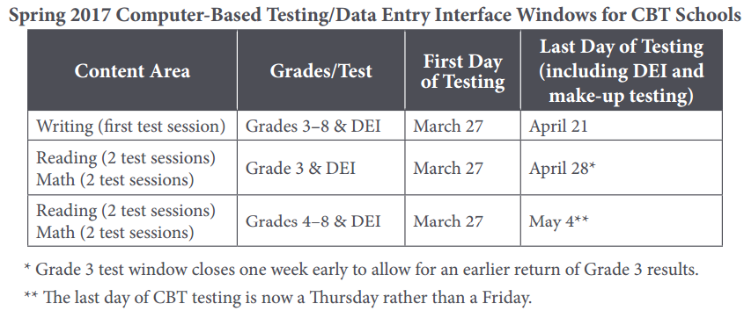
Help with Make-ups
Please fill out Google Doc for EACH Session and Teacher Name (look at bottom TAB for grade level)
Notes:
3rd grade test window closes one week early to allow for an earlier return of Grade 3 results. Wanted to give as much time possible so PEC testing a week after window opens. This gives some time for make-ups but will need to be diligent in grade 3 to help with Make-ups. 3rd grade writing begins on Tues April 11th… Make-ups must be DONE for writing by April 21st (we are out of school on April 14th & 17th)

Slide 6
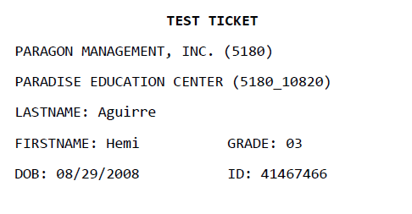
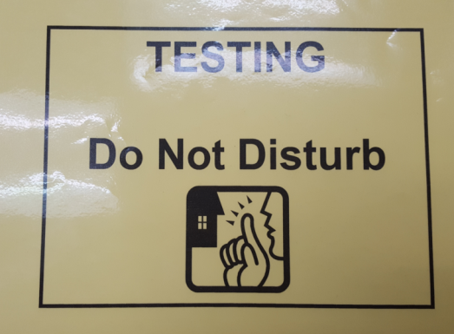
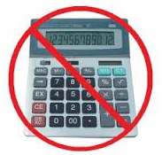
Test Materials
TA’s must have copy of manual
Please POST “Testing- Do Not Disturb Sign” on door
Scratch Paper is prohibited for ELA Reading (plain, lined, or graph only for Writing and Math)
Notes:
page 3 of Testing Manual- online or my website
If you need Pencils or scratch paper then please let me know prior to testing. Calculators are prohibited unless in 7th or 8th for PART 1 only

Slide 7
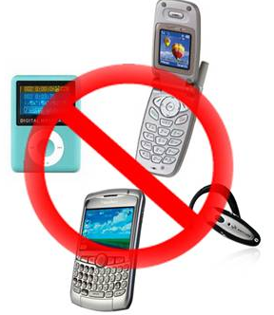
Use of Unacceptable Resources
Notes:
page 5 of Testing Manual- remove violation and allow student to continue testing. Contact testing coordinator about unacceptable resources

Slide 8
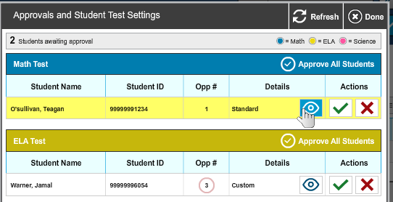
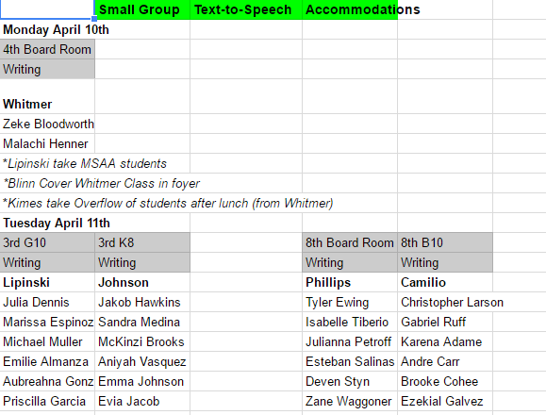
Testing Accommodations
Text to Speech
Small Group
Notes:
NEED PRINT OUT of TEXT to SPEECH accommodations/SMALL GROUP Schedule Google Doc
page 6 of Testing Manual – Students with accommodations have already been added to TIDE. There are two accommodations that will be used 1) Text to Speech for Math and Writing section 2) Small Group The testing Administrator must know which students are eligible for accommodations AND must provide accommodations. First way to check for accommodations for Math and Writing text-to-speech. Look on Approvals screen for CUSTOM setting. Second,

Slide 9
Before AzMERIT Administration

Slide 10
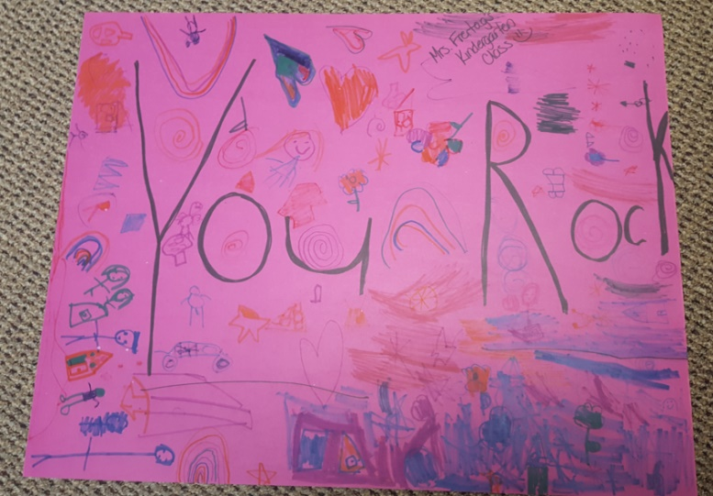
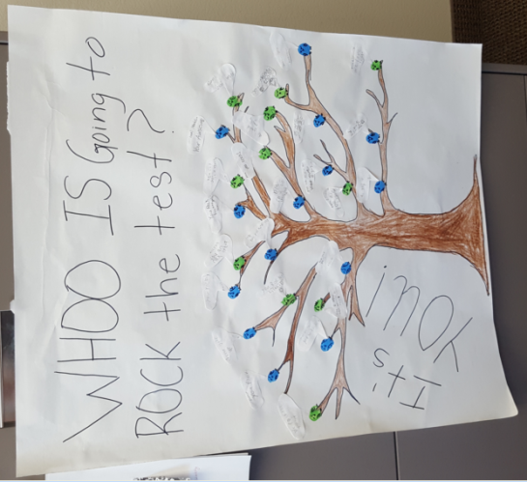
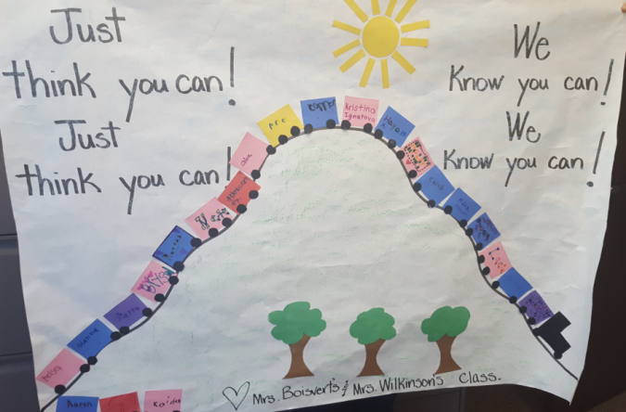
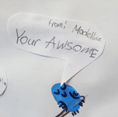
Prepare the Room
Students’ desks and tables should be cleared of backpacks and unnecessary materials prior to the beginning of the test session
Notes:
page 6 of Testing Manual- K-2 students have created posters for your students to ENCOURAGE your students

Slide 11
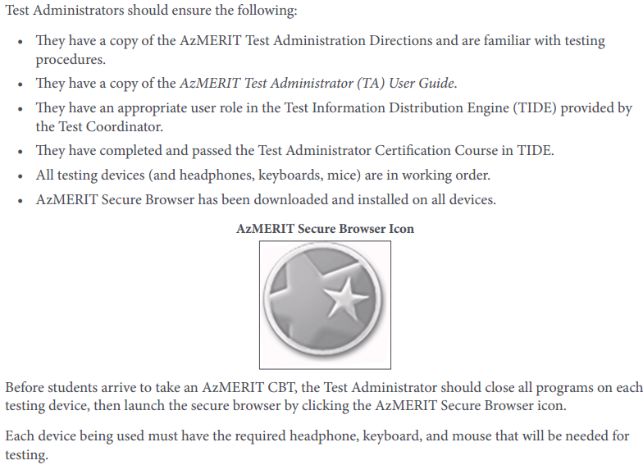
Preparing for Computer-Based Testing
T﻿he student sign-in screen should be showing when students enter the room to take the test. In the event of technical difficulties with the secure browser, contact your Test Coordinator.
Notes:
page 7 of Testing Manual- Be aware that the student sign-in screen should be showing when students enter room to take the test

Slide 12
During AzMERIT Administration

Slide 13
Preparing for Computer-Based Testing
*Please review the directions in advance to become familiar with the scripted text and testing procedures.
.
*Read aloud to students only what is marked with a “SAY” and printed in the boxes
Pgs 15-18 Writing
Pgs 19-21 ELA Part 1 or 2
Pgs 22-24 Math Part 2 or 2
Notes:
page 9 of Testing Manual- Be sure to TAB these pages for CBT only

Slide 14
Monitoring Student Testing
*continuously move about the room
Notes:
page 10 of Testing Manual-continuously move around room to ensure using appropriate testing materials and resources

Slide 15
Breaks DURING Testing
The student must pause his or her test before leaving the room. The student will be required to sign in to his or her test when he or she returns to the room, and the Test Administrator will need to approve the student again
20 minute MAX time to have test paused
Notes:
page 9 of Testing Manual- Individual students may use restroom…must pause test and then log back in. Once leave the testing room, then the session will be over. What to do about lunch?

Slide 16
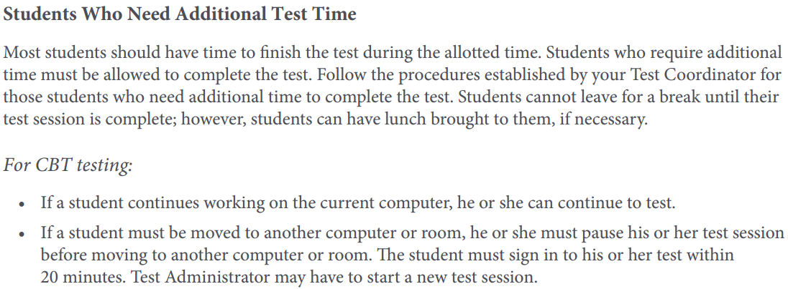
Students Who need Additional Time
3:00 pm
Lunch Overflow Room
Which classroom would like to be designated as the Lunch Overflow room?
-Text Angela to bring lunches to students
-Continue testing/must log in BEFORE 20 minutes have passed
-Remaining Students from Lunch Overflow room farmed out (email list Synthia please)
Notes:
page 11 of Testing Manual- Must be allowed to finish test—can go up to 3:00 pm

Slide 17
Students Who Leave DURING testing
The Test Administrator should inform the student that he or she will not be permitted to finish that session when the student returns to school.
Notes:
page 11 of Testing Manual- Must be allowed to finish test—can go up to 3:00 pm

Slide 18
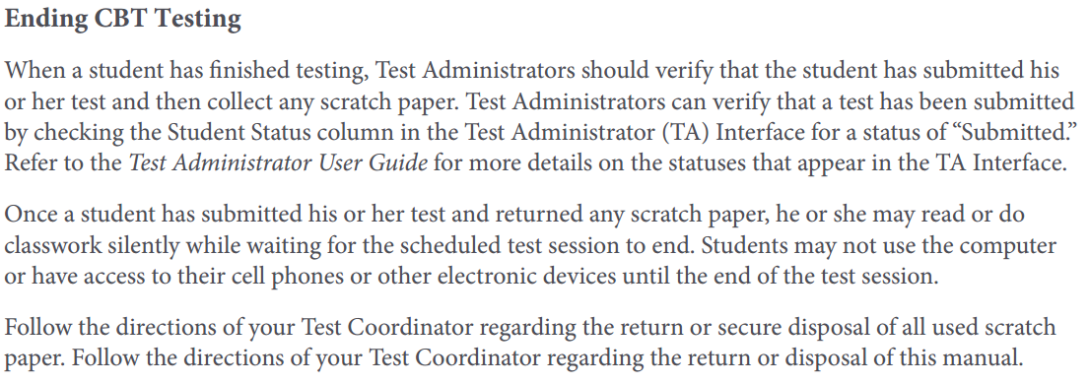
End of AzMERIT Testing
*verify that the student has submitted his or her test (Interface)
*collect any scratch paper
*once finished then students will read or do classwork silently
MAY NOT USE THE COMPUTER until the end of testing
Notes:
Page 11 of Testing Manual-

Slide 19
Practicing for Azmerit

Slide 20
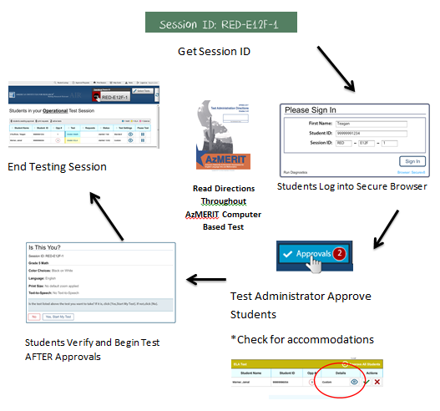
Friday April 7th 3:00-3:30 Cluster Room
*Launch the AzMERIT Secure Browser on each student Chromebook *Write the Session ID clearly on the board *Post “Testing Do Not Disturb Sign” *Distribute testing tickets *Distribute Scratch Paper (only Math and Writing)

