Slide 1
AzMERIT Training

Slide 2
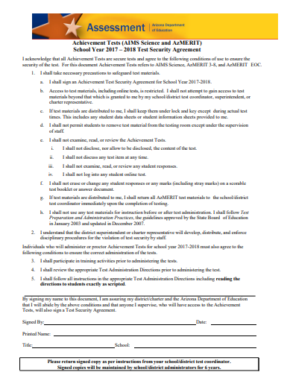
Ticket In
Please sign in & get handouts
-Read, Sign, Return Testing Verification
Fast Finishers: azmeritportal.org

Slide 3
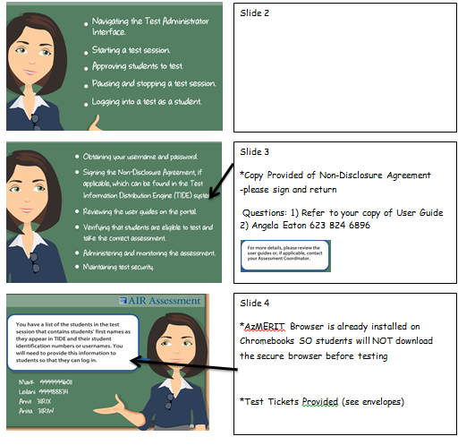
Preview of Lesson
Ticket In
-Testing Verification form
Objective
-complete test administrator online course
How to Access online training
-handout provided
Online Training
-azmeritportal.org
-quiz at end of training (use handout for hints ☺)
Closure
-Once online course is finished you are done

Slide 4
Learning Target:
By the end of PD, staff members will sign test verification form (ticket in) and complete test administrator online training.
*Specific details for AzMERIT (schedules etc.) will be discussed during Clusters

Slide 5
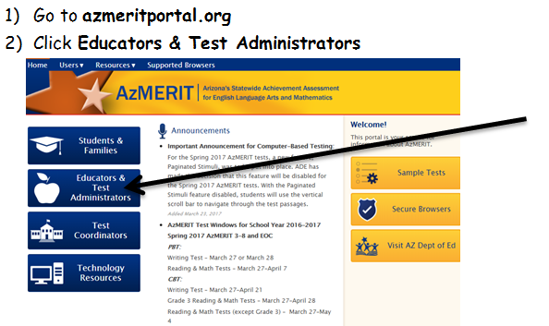
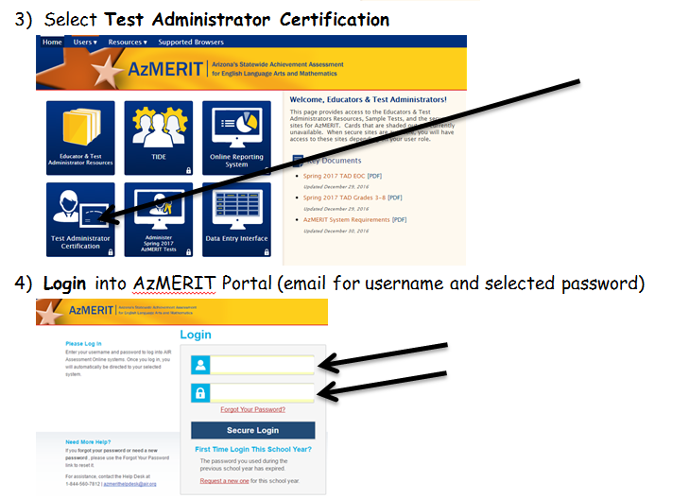
Test Administrator Certificate

Slide 6
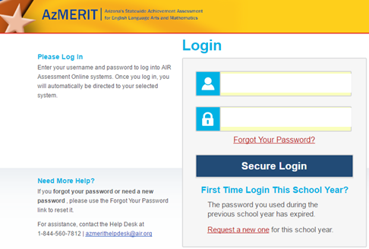
Retrieve Password

Slide 7
New Security Feature
Code sent through email
*new security feature for all users 2019
*applies every time you access TIDE with a new browser
*Enter emailed code Click Submit

